Slide 1







GitHub Copilot for Almost Everyone
Tim Warner
timw.info/linkedin
Notes:
How much flexibility am I allowed with these slide layouts? If you right-click a slide, you can play with layouts, but otherwise, not much flexibility.
Am I free to add my own graphics, providing MSFT attribution where necessary? When it comes to MS graphics, we're not allowed to use those, so please do not add in graphics unless they are created FROM SCRATCH by you.
Can I make the font a bit smaller? Some of the objectives are verbose and I don’t want to crowd the skills? Yes, I do this, too, when I review the slides because sometimes the default size just won't work.
Do the bullet points here need to be word-for-word from the outline or can I condense? We prefer word-for-word, but some of the sub-lesson titles are super long. Use your discretion, and we can address case-by-case during the review of each lesson's slides.

Slide 2
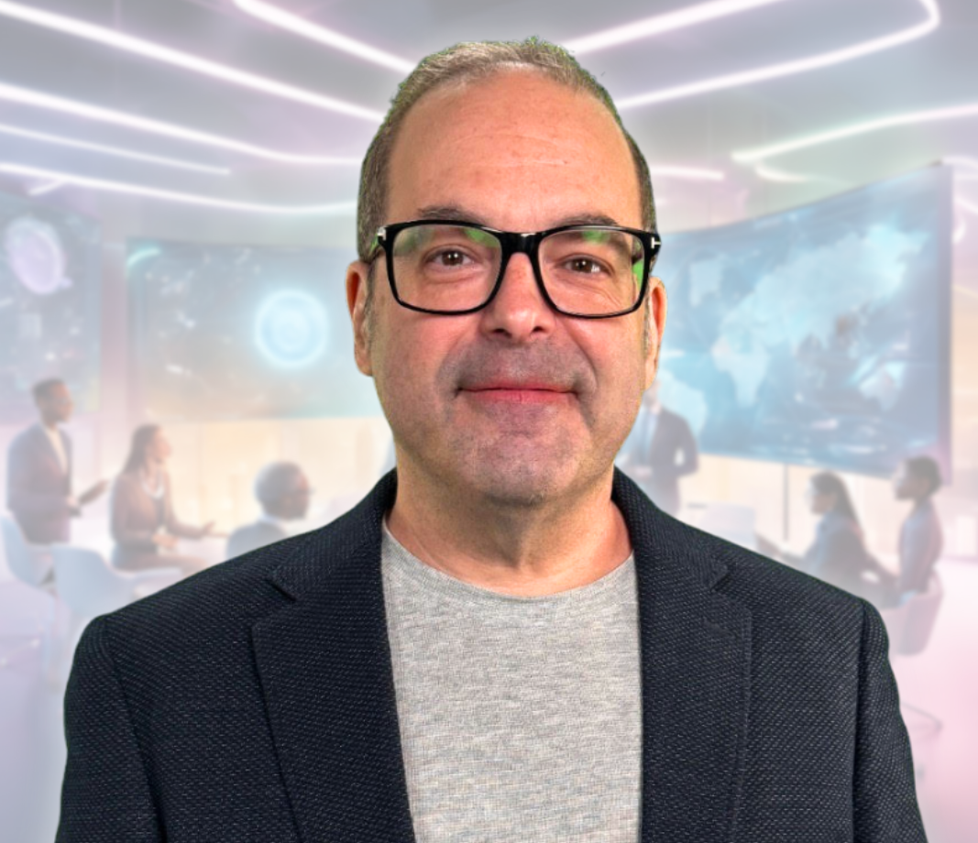
Tim Warner
Based in Nashville, TN, US
28-year Microsoft Certified Trainer (MCT)
8-year Microsoft MVP in Azure AI
Contact: TechTrainerTim.com

Slide 3
Course Flow (Central Time Zone)
09:00 am - Start - Segment 1 [Foundations]
10:00 am - 10-min break - Segment 2 [MCP]
11:00 am - 10-min break - Segment 3 [Agents]
12:00 pm - 10-min break - Segment 4 [Skills]
01:00 pm - Finish

Slide 4
Course materials
timw.info/claude

Slide 5
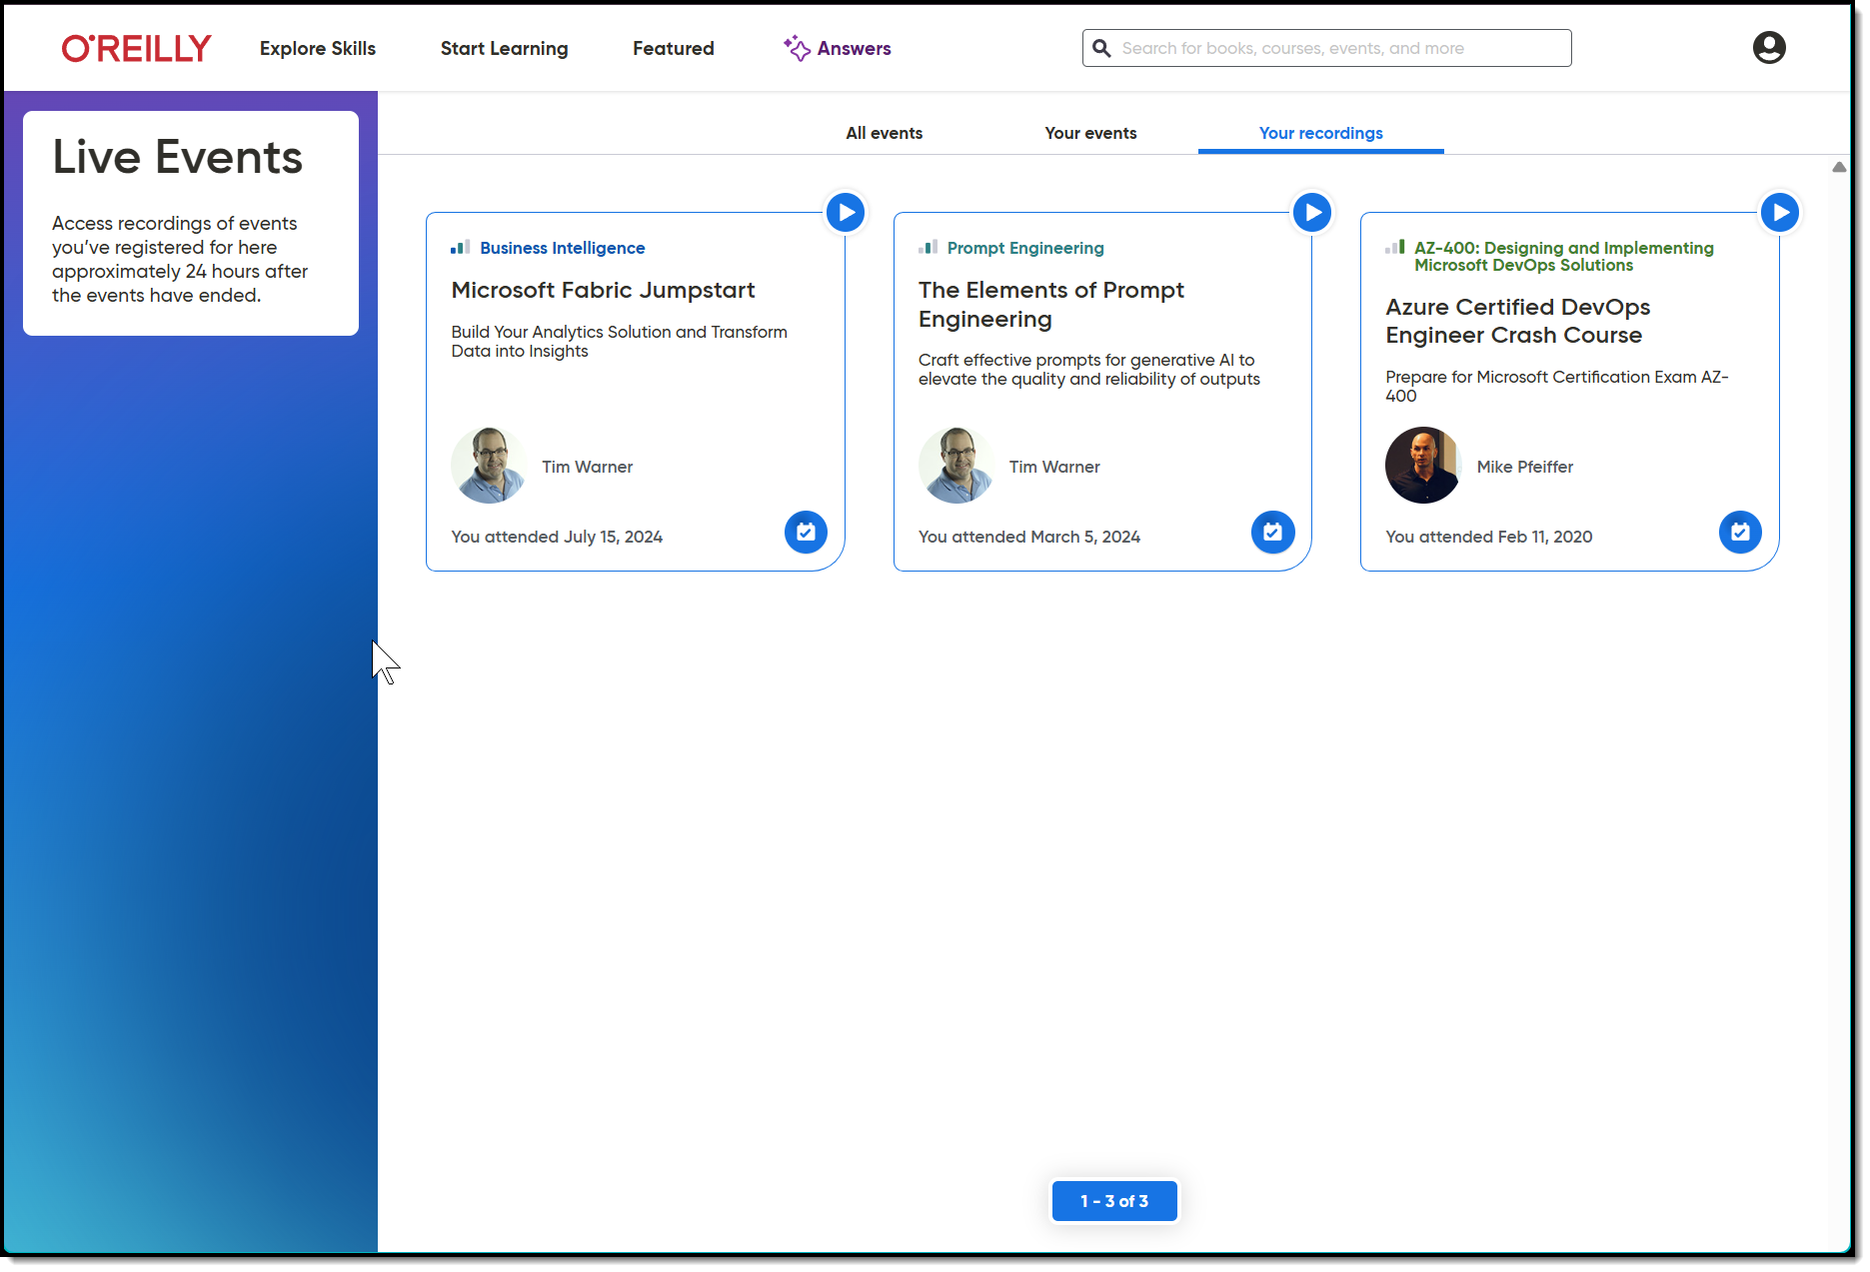
Session Recording + Badge

Slide 6
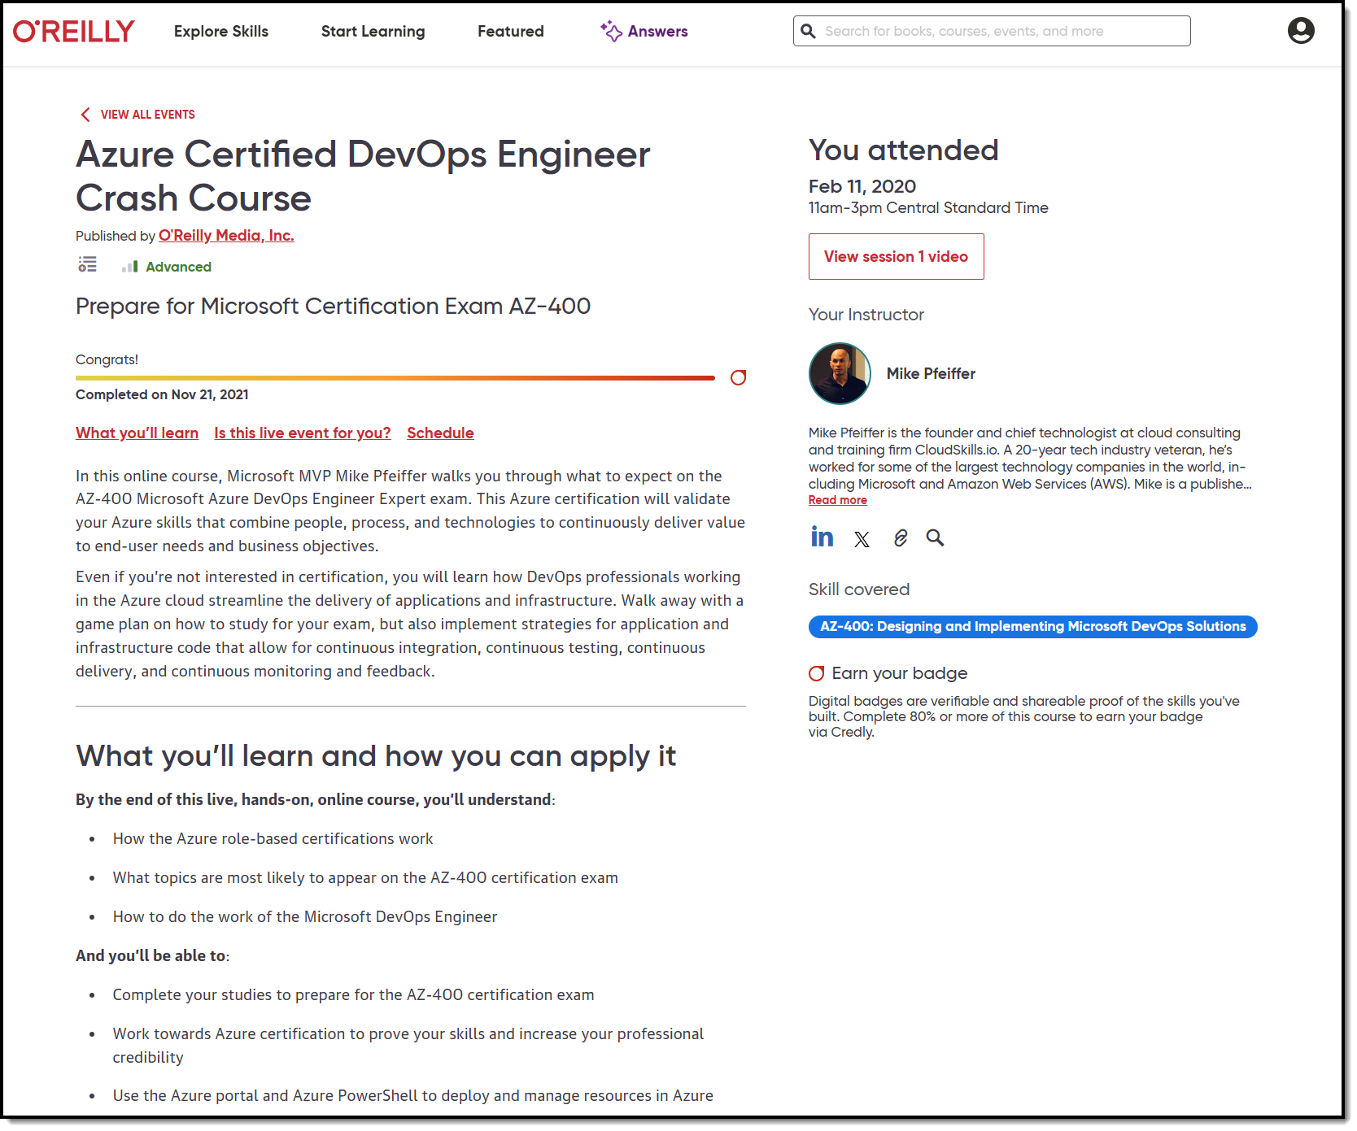
Session Recording + Badge

Slide 7
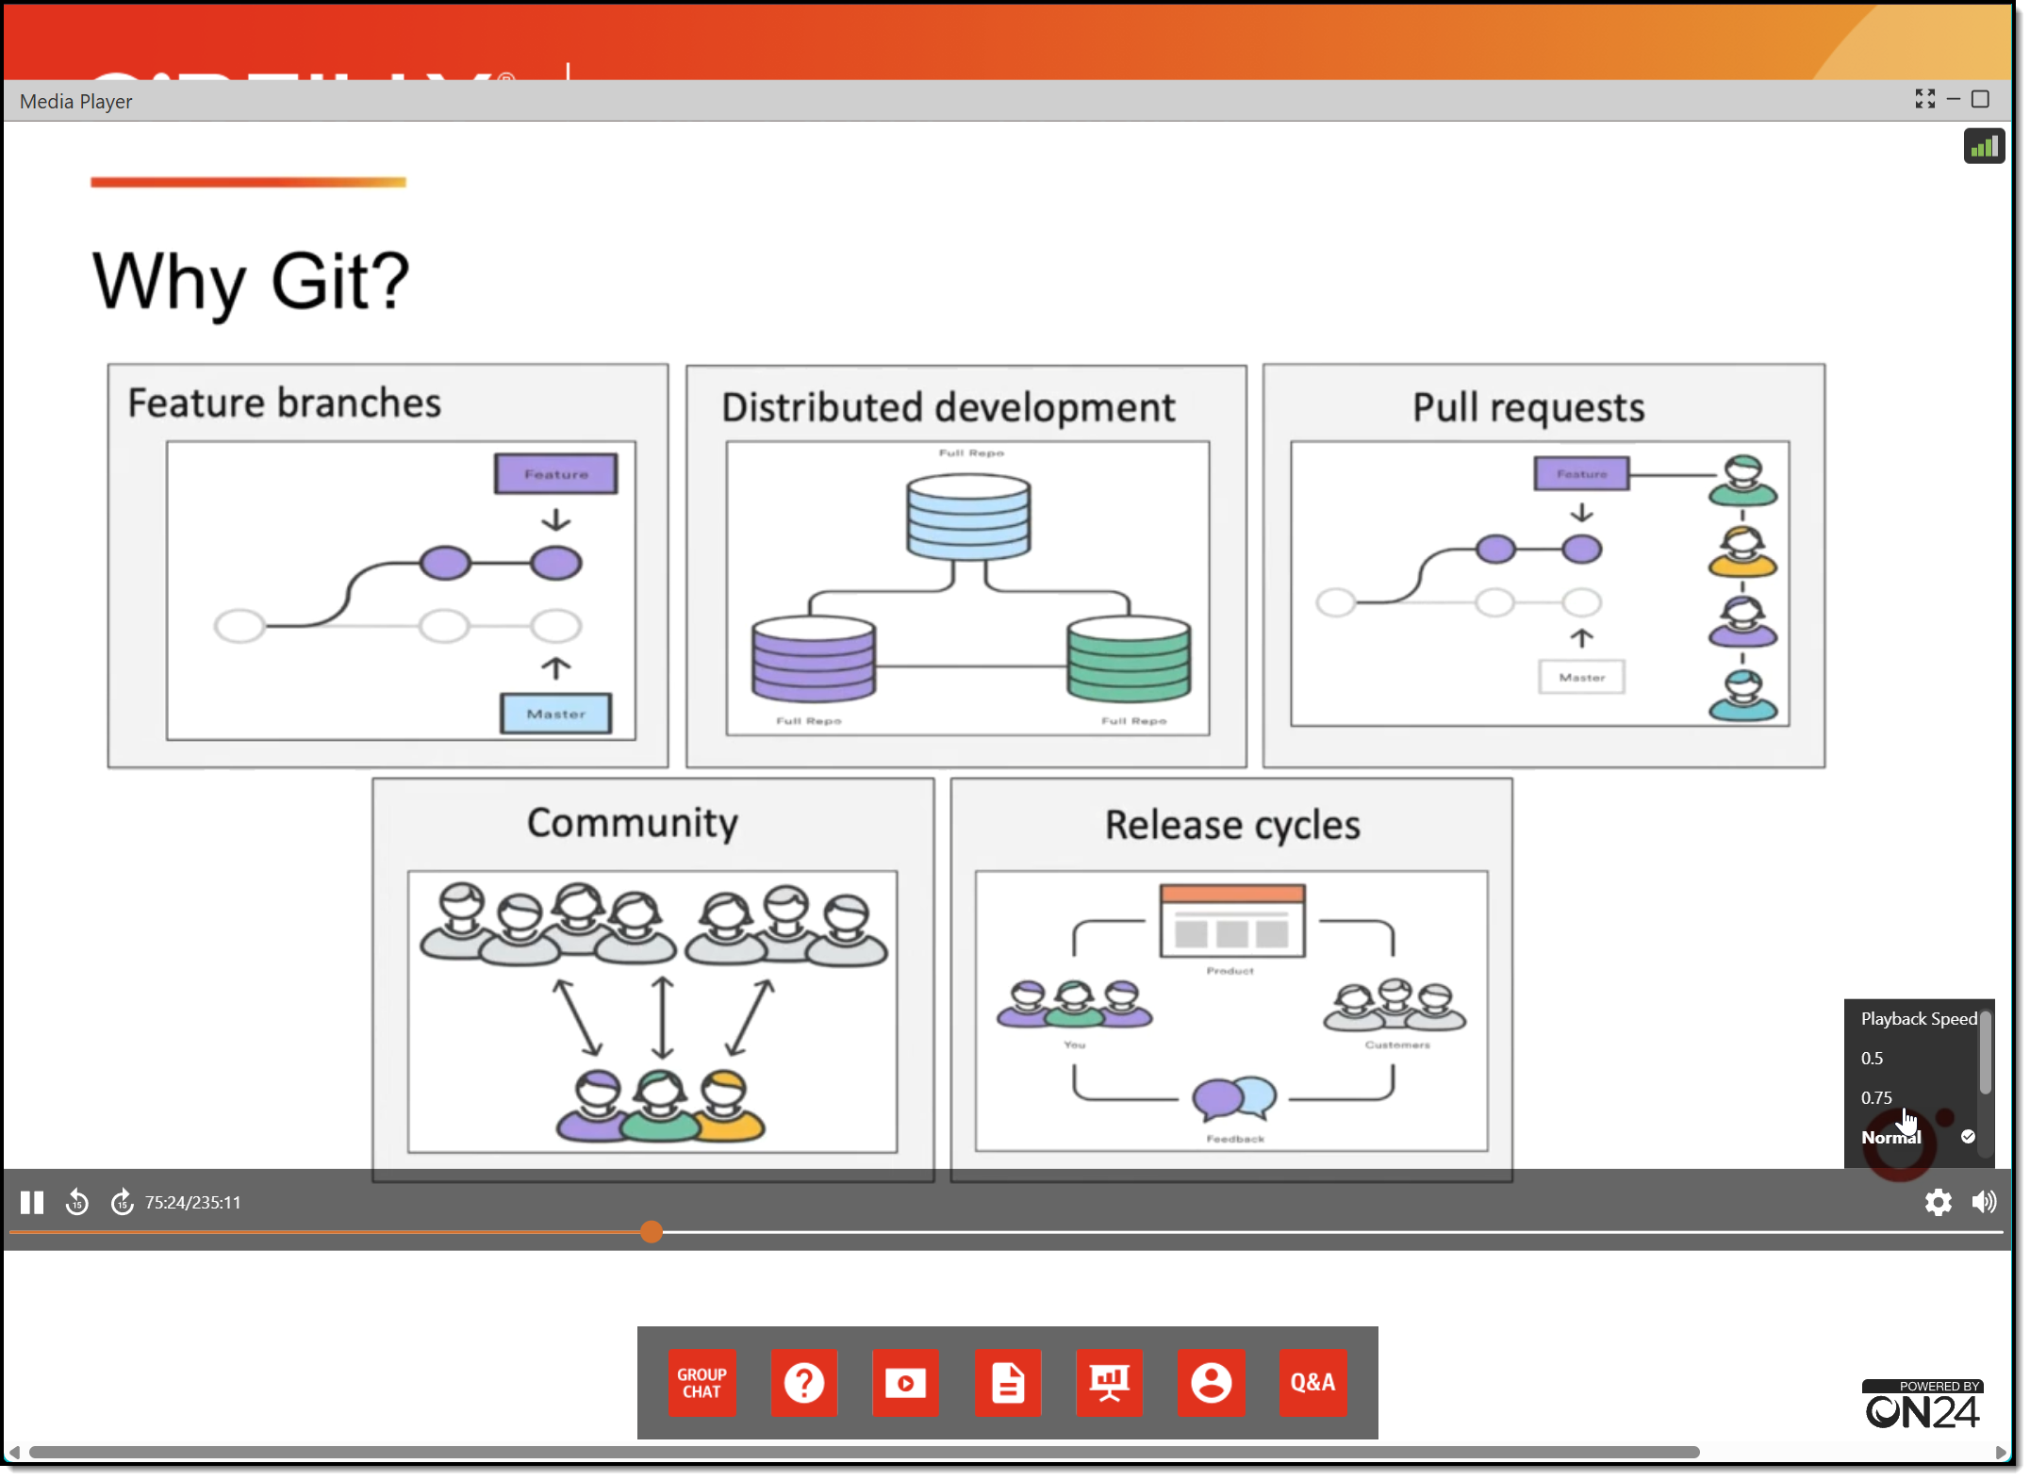
Session Recording + Badge

Slide 8
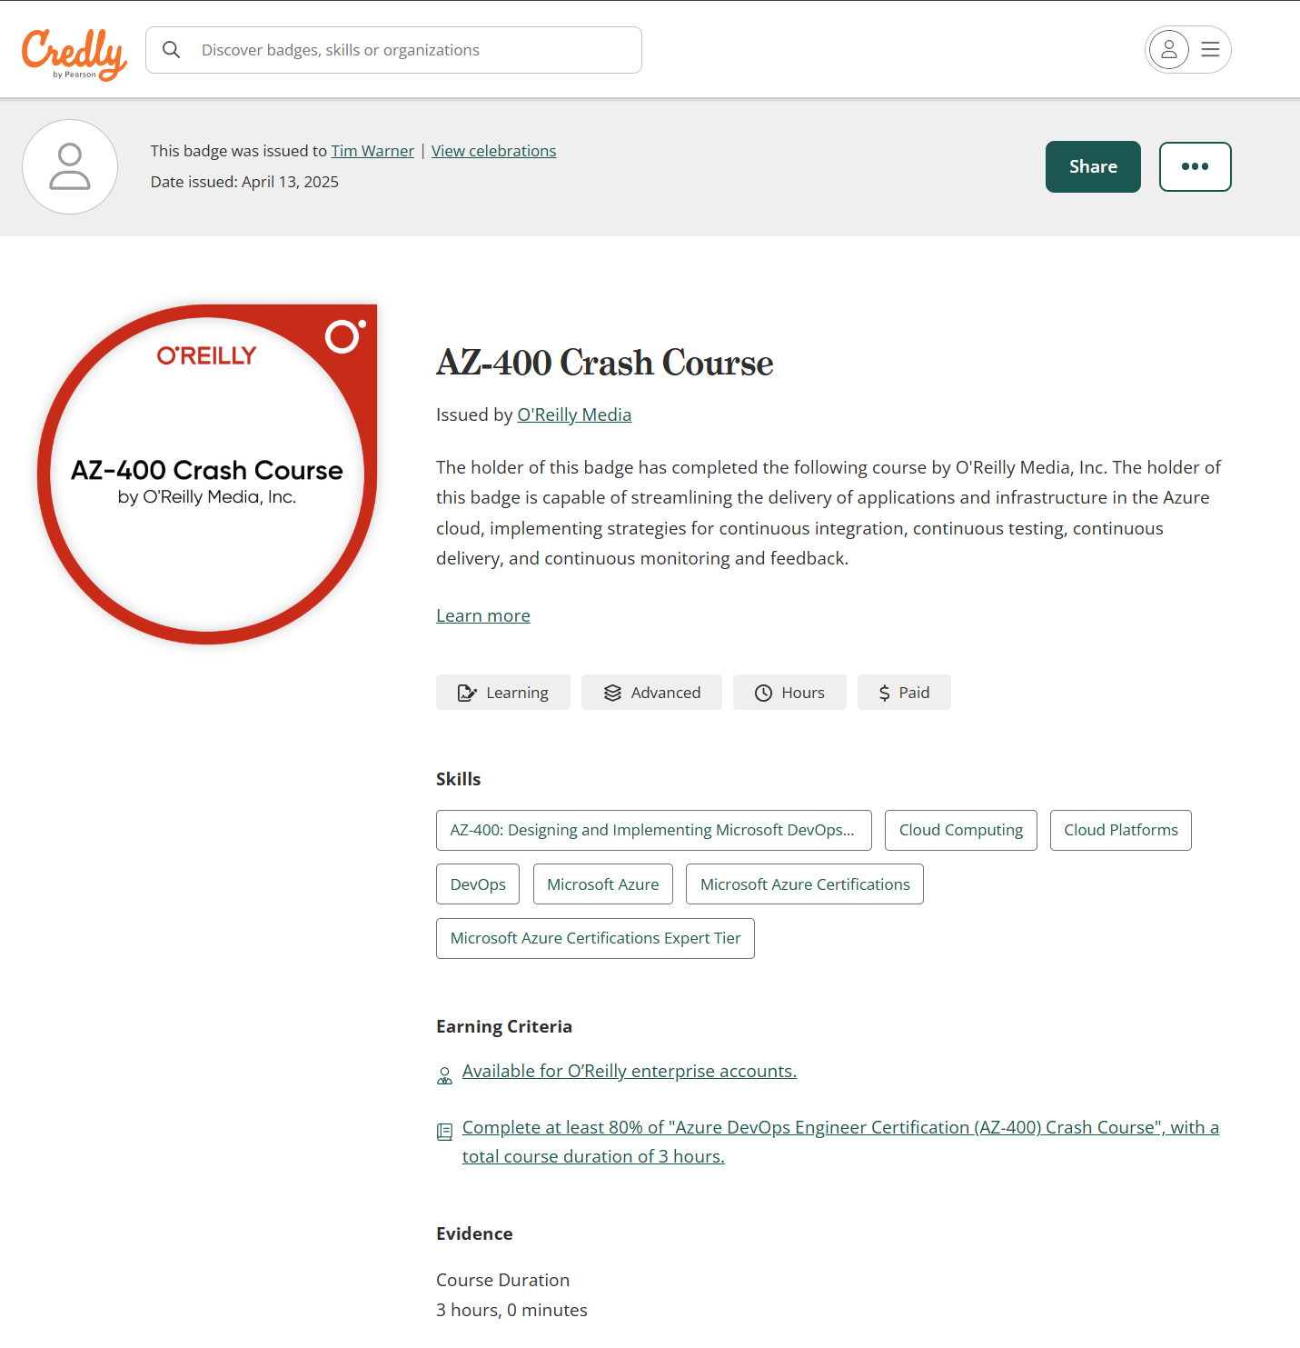
Session Recording + Badge

Slide 9
Questions?
Please add questions to the Q&A window so I don’t miss them
Only O’Reilly folks and I can read them
Your name shows up as initials with no company name

Slide 10


Slide 11
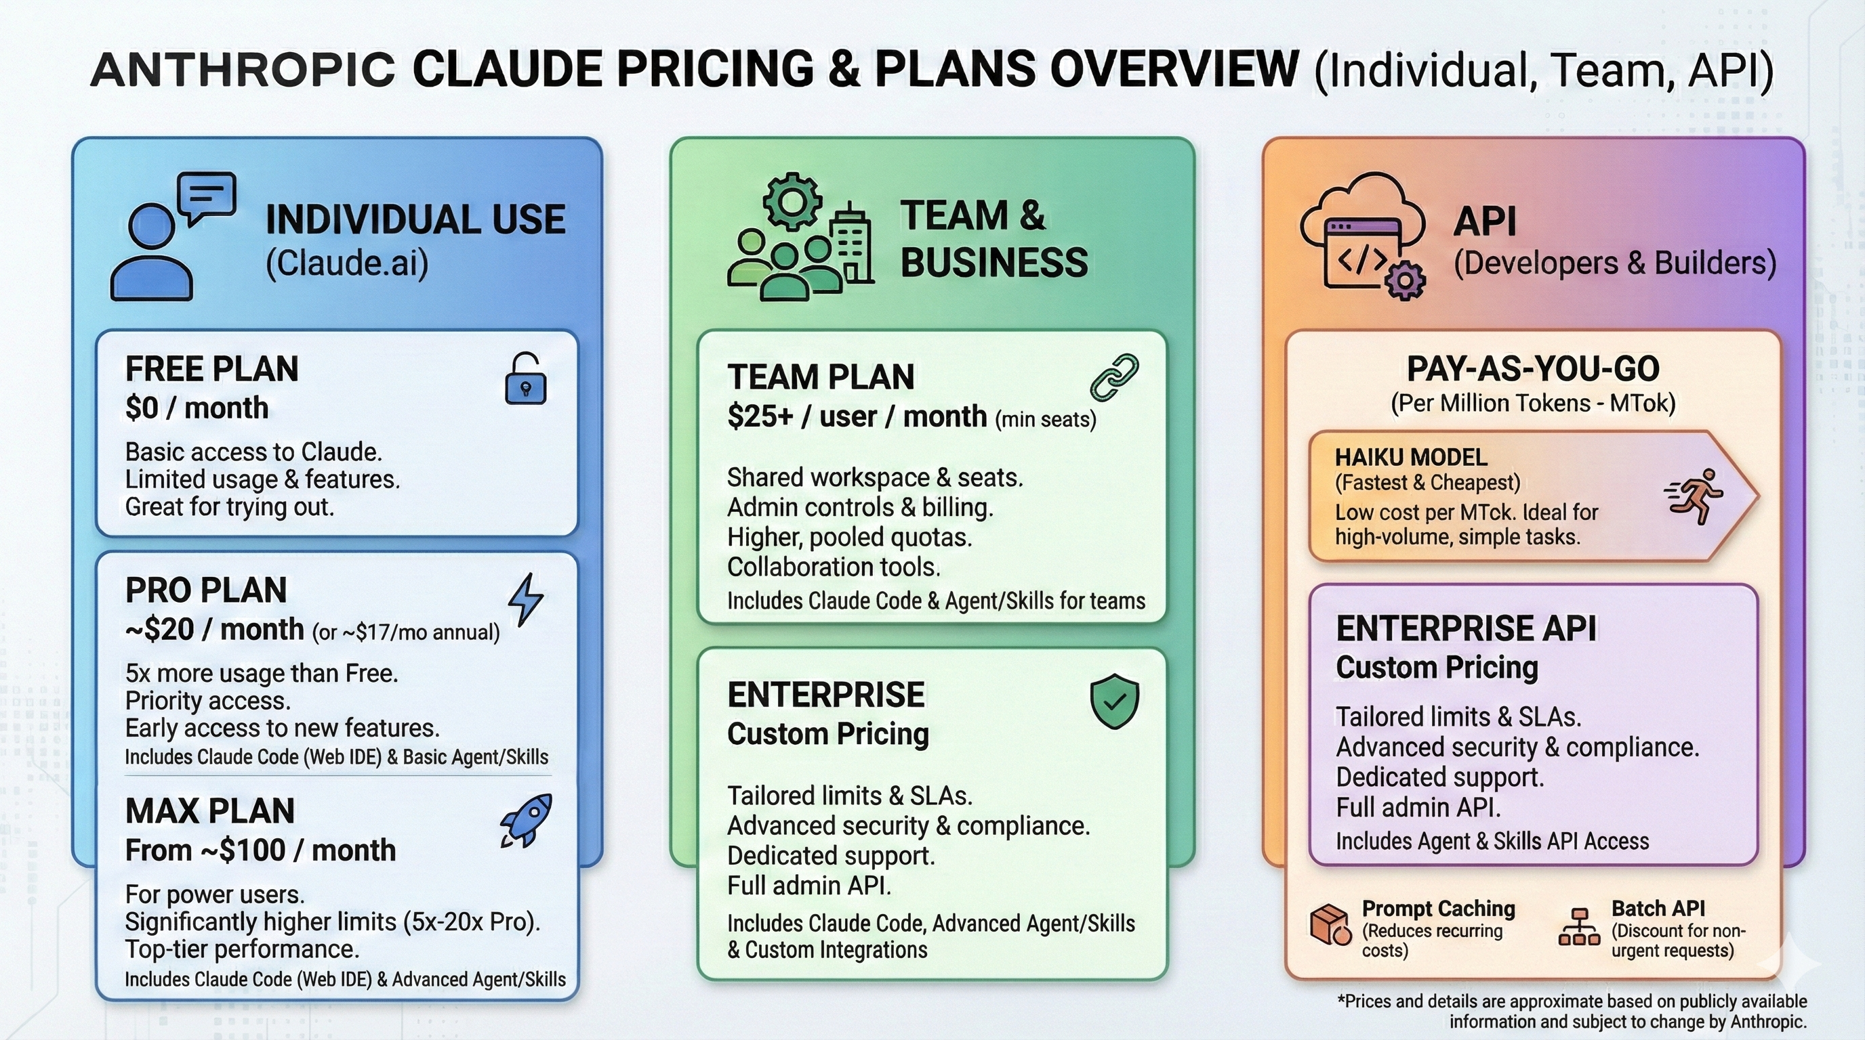

Slide 12
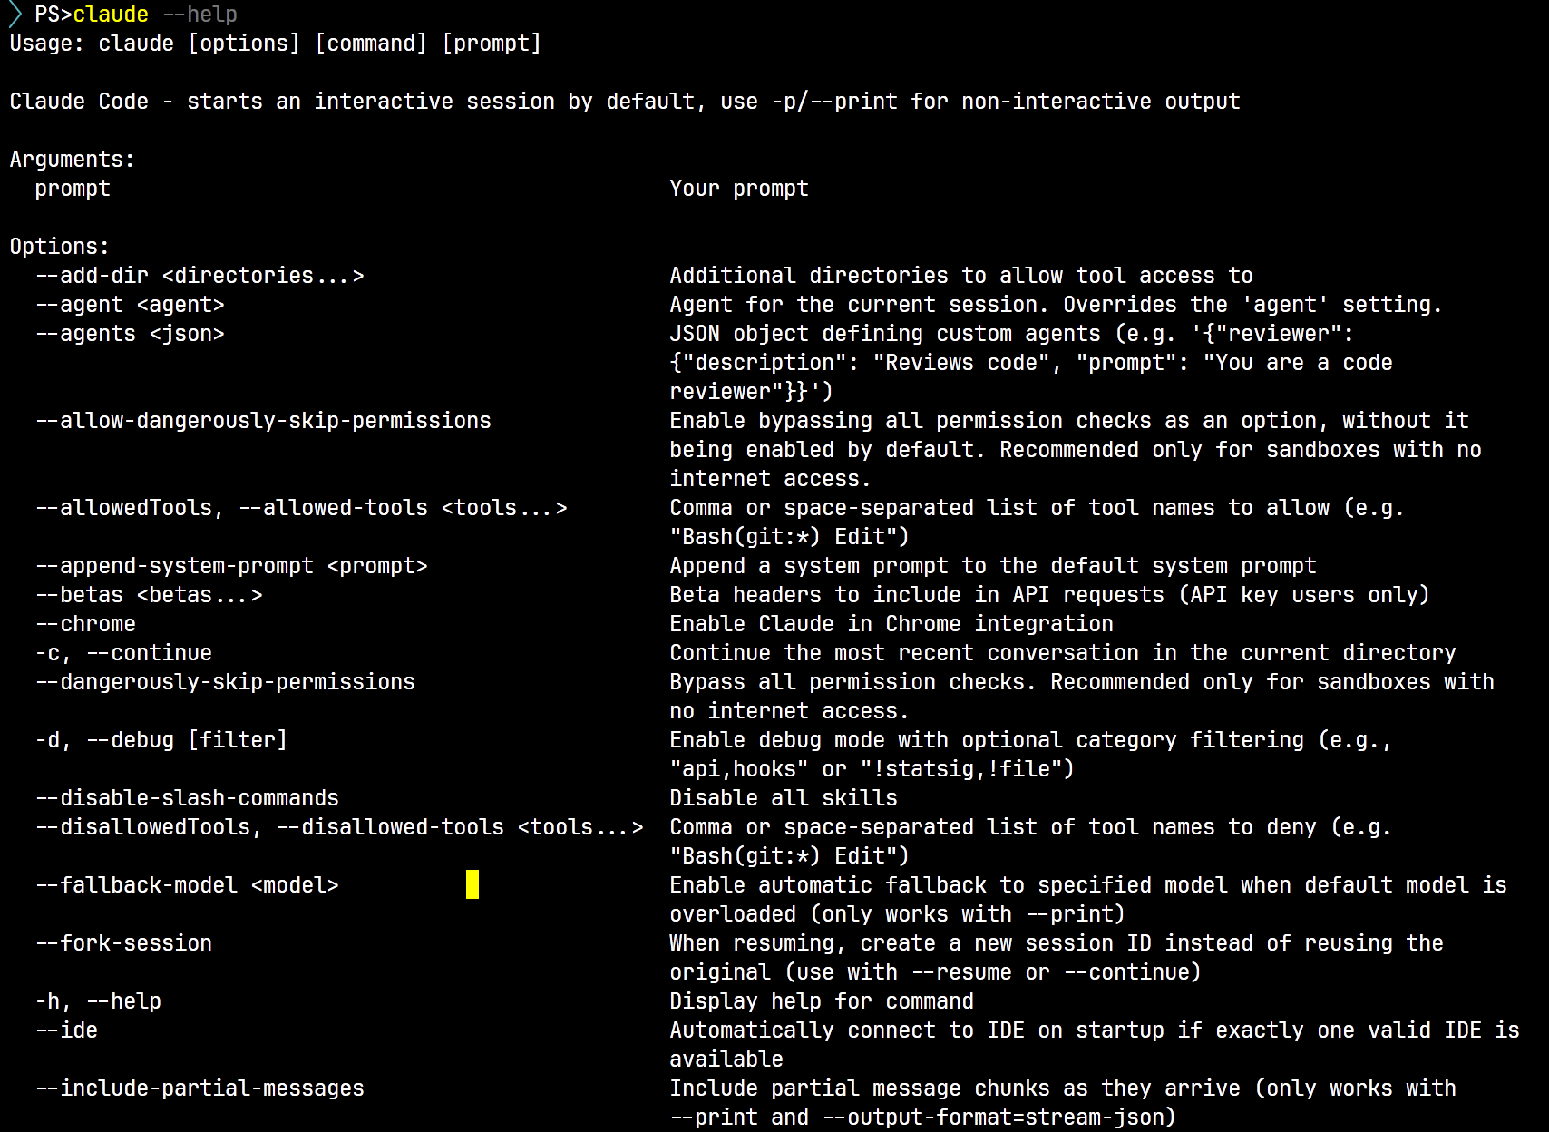

Slide 13
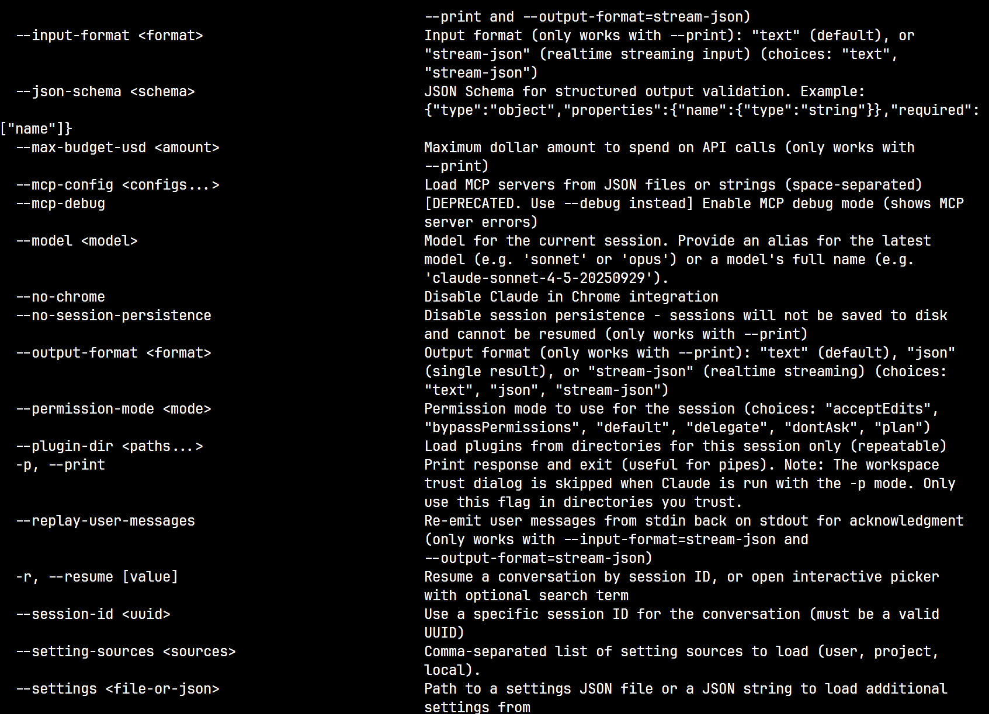

Slide 14
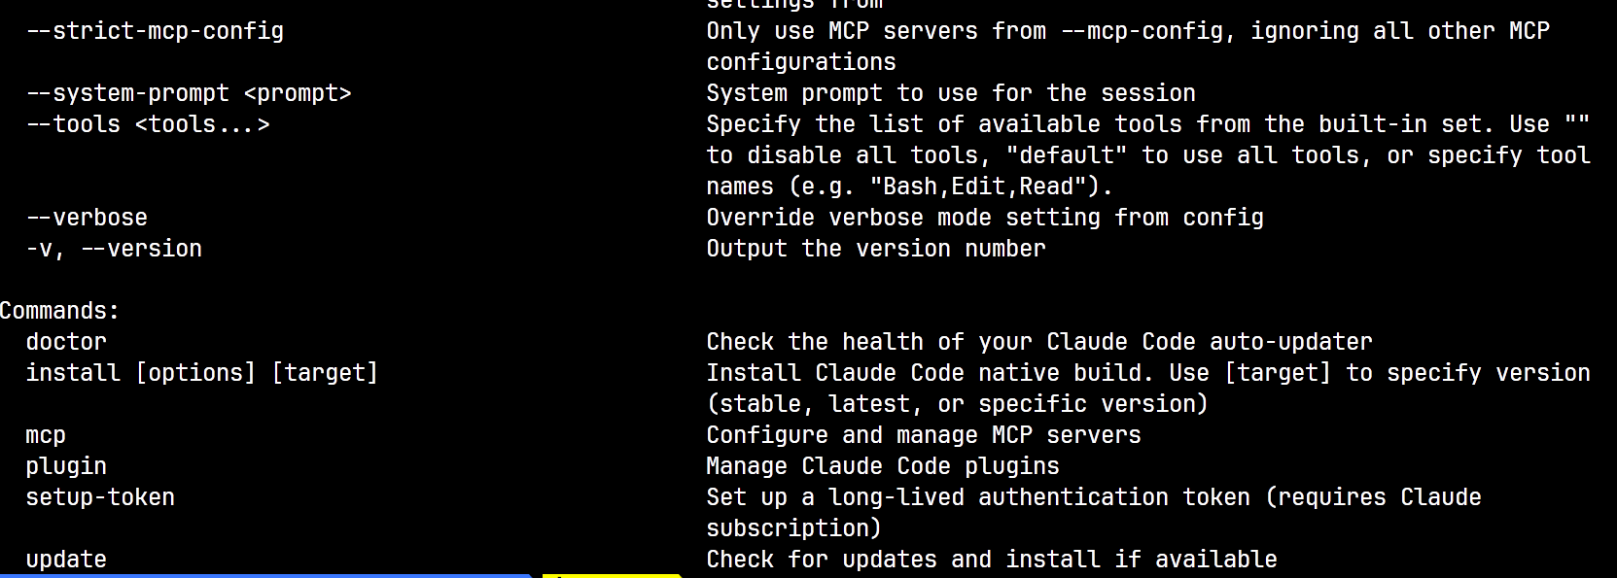

Slide 15
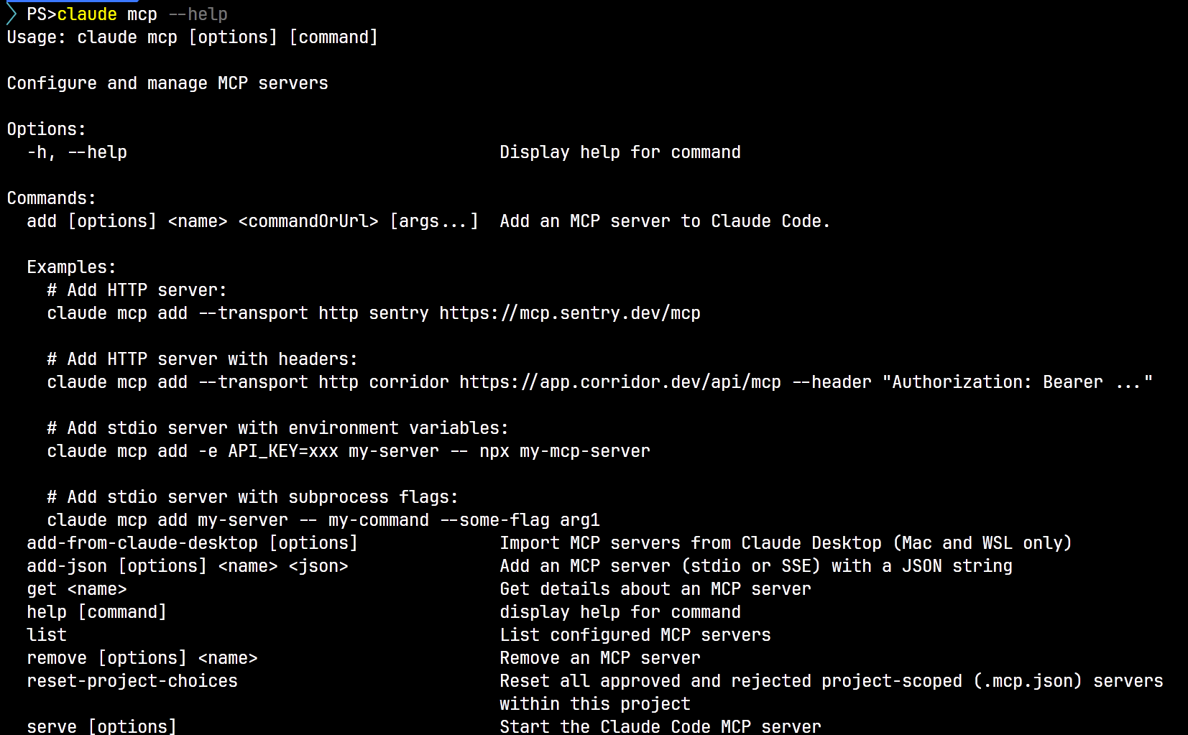

Slide 18
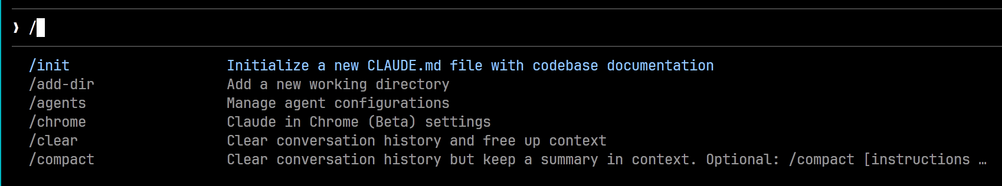
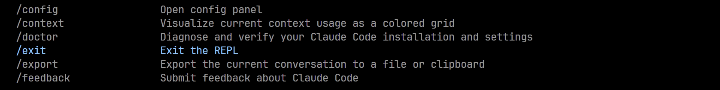
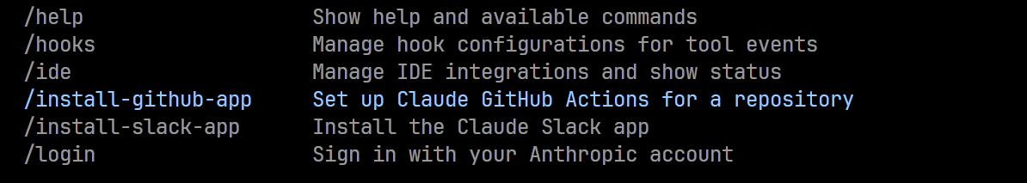

Slide 19
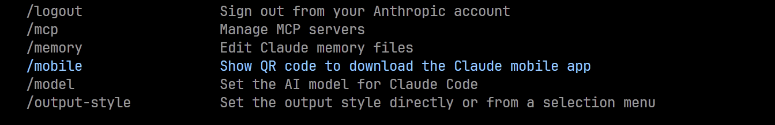
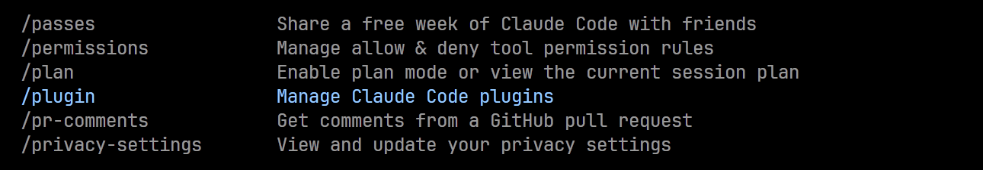
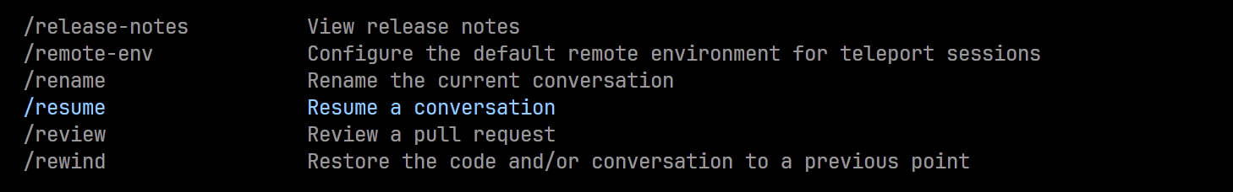
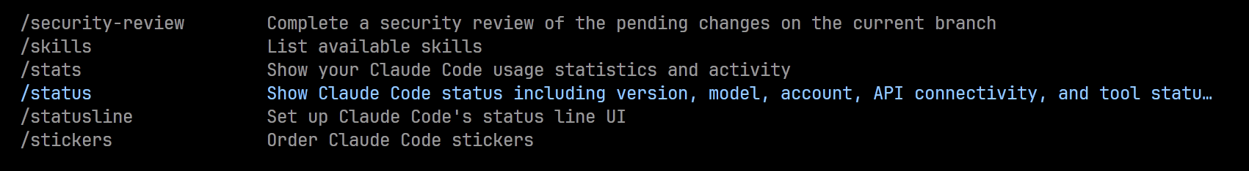

Slide 20
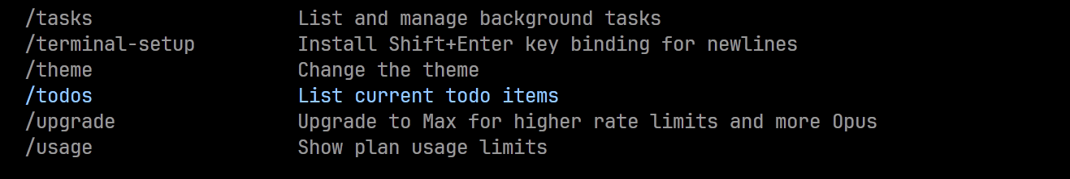
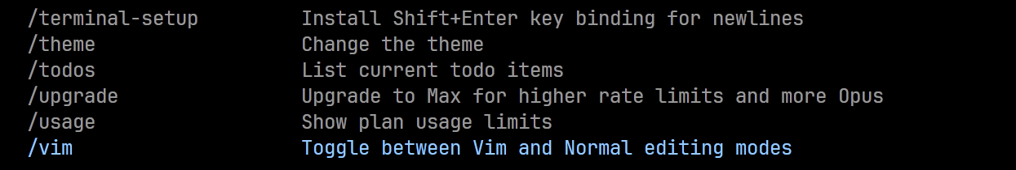

Slide 24
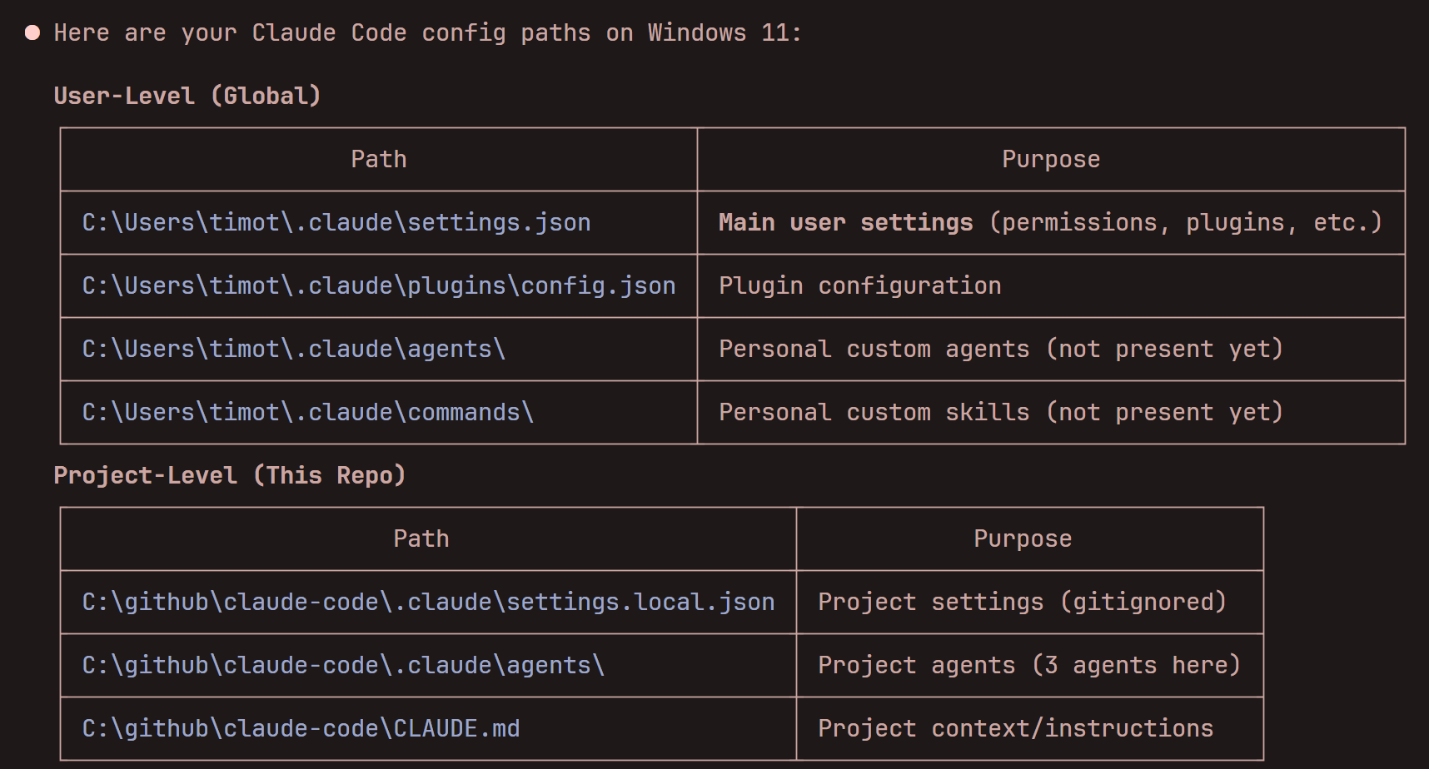

Slide 25
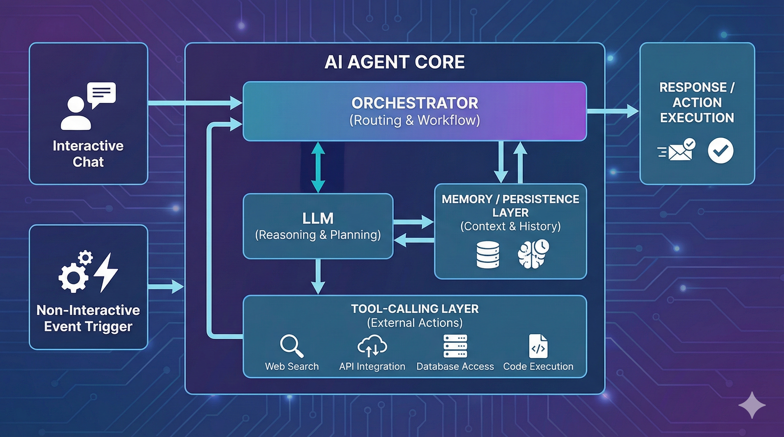

Slide 26
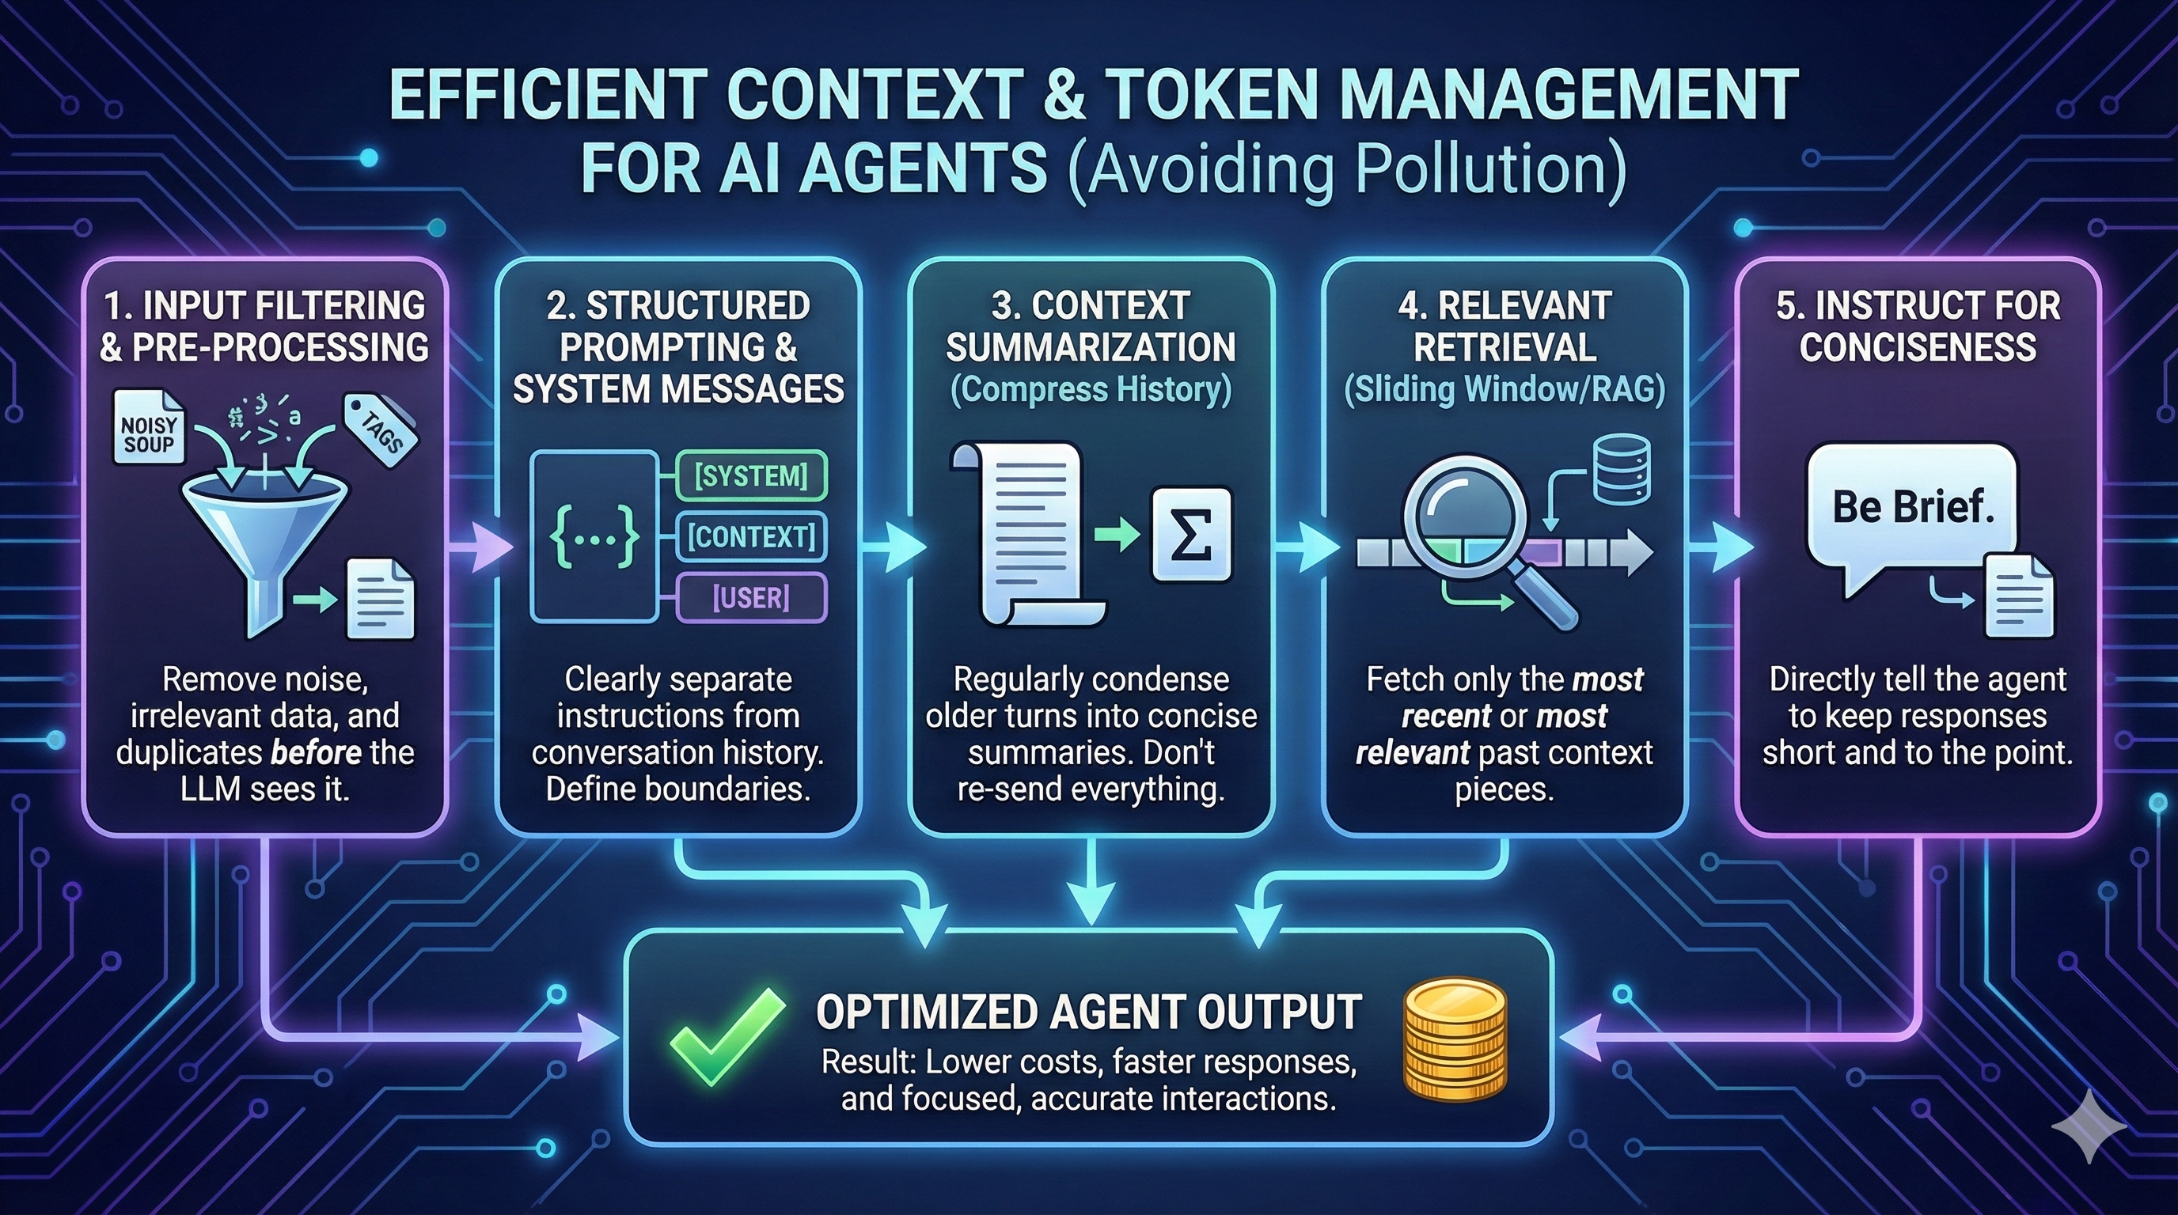

Slide 27
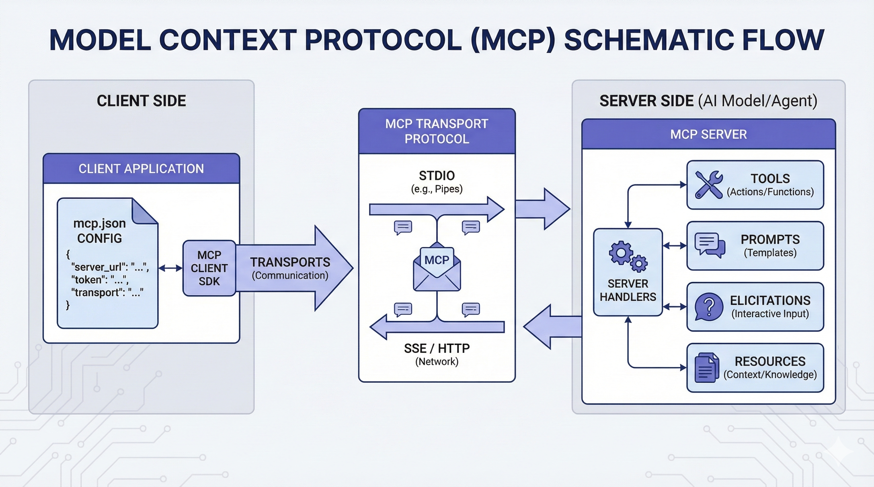

Slide 28
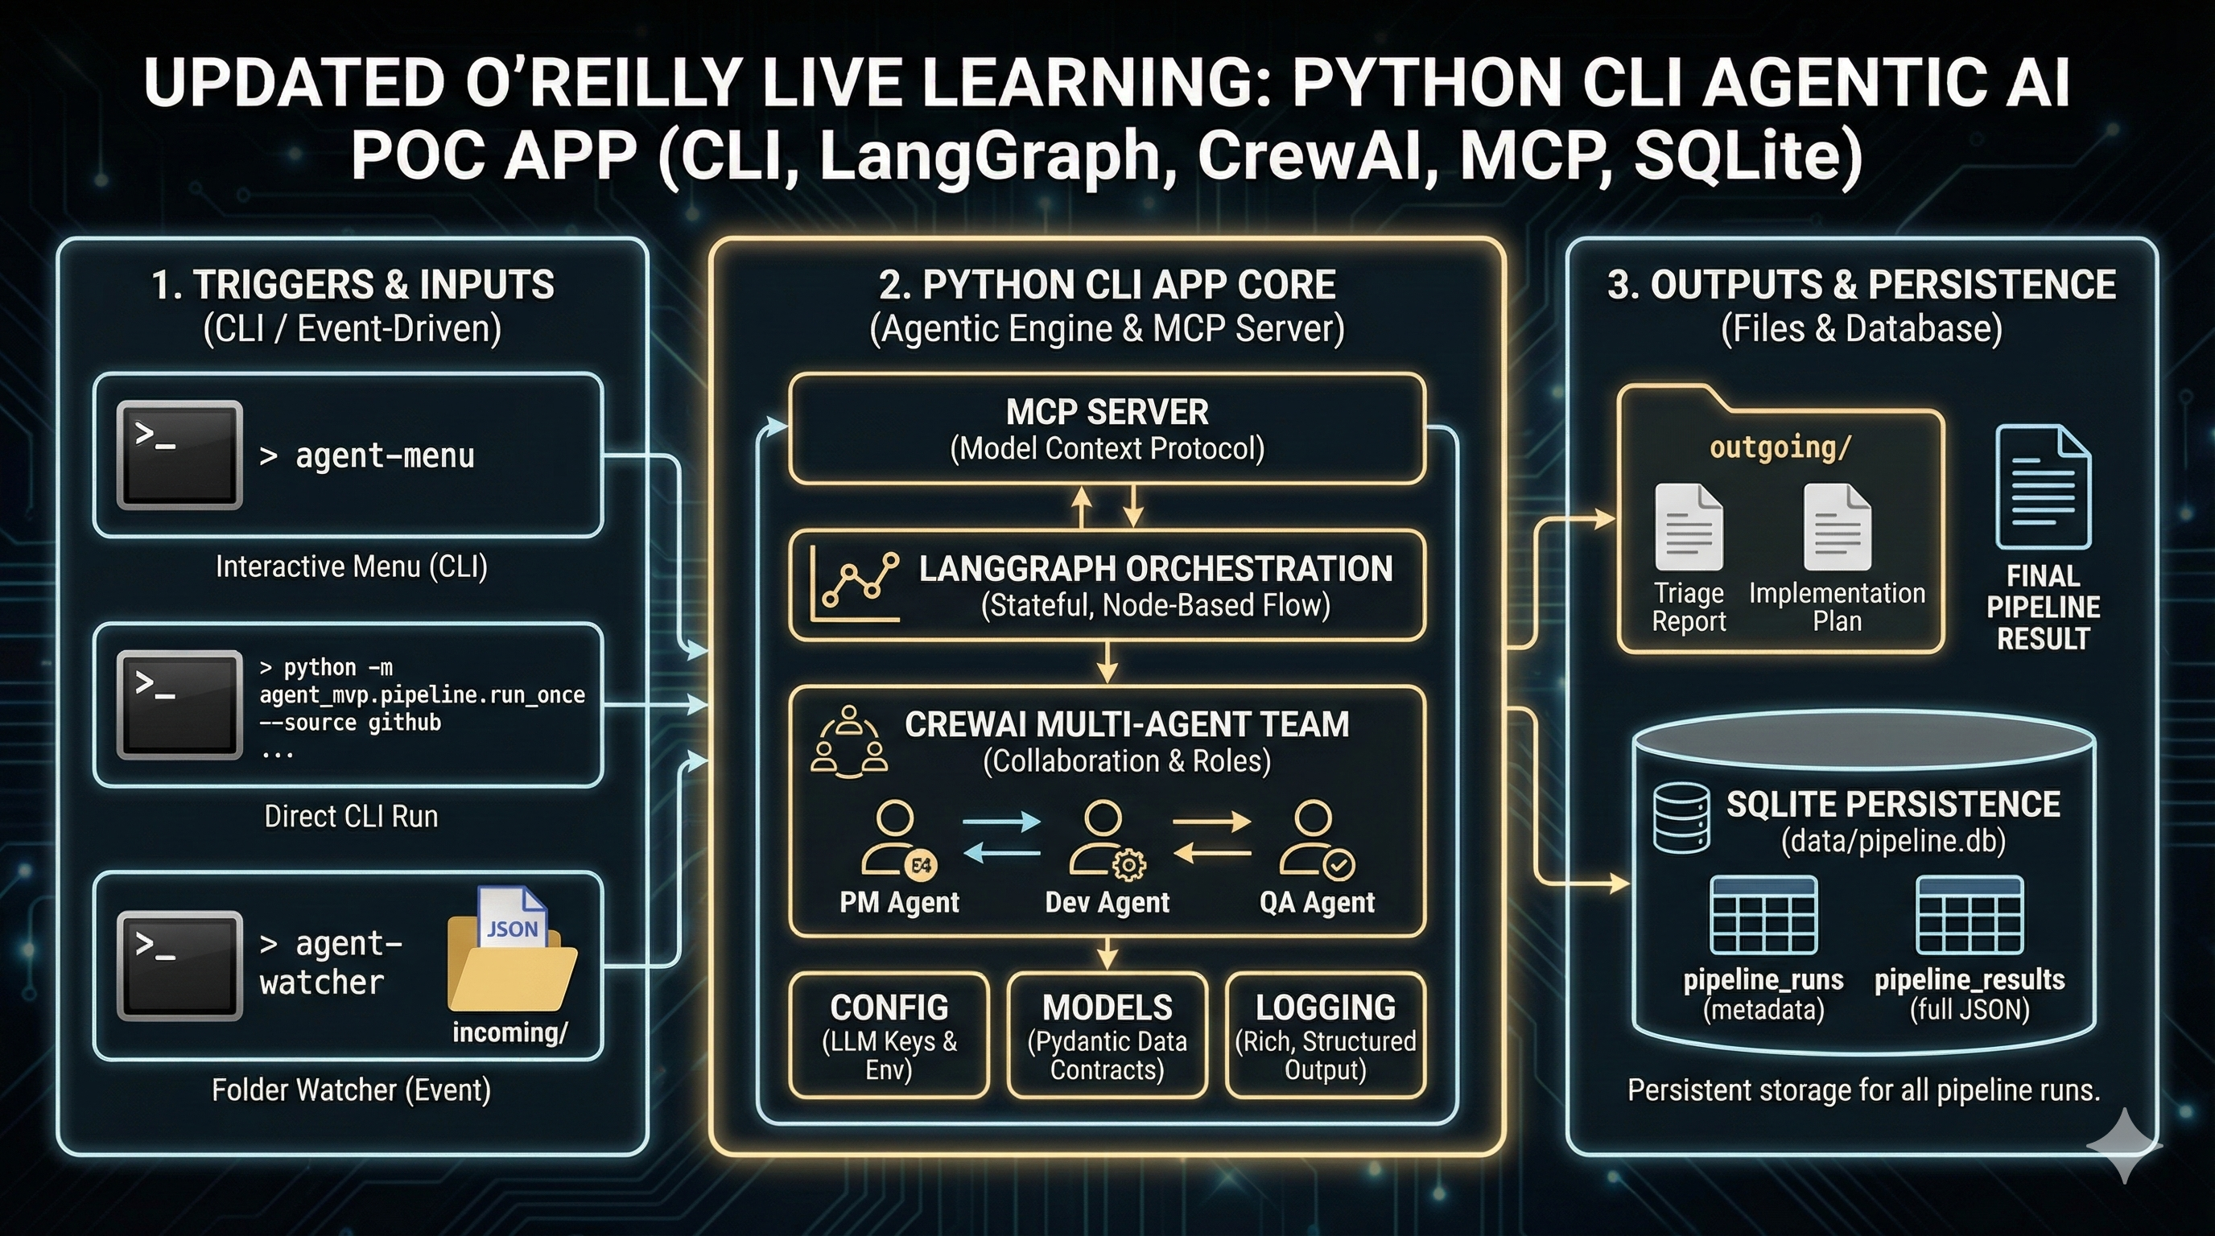

Slide 29
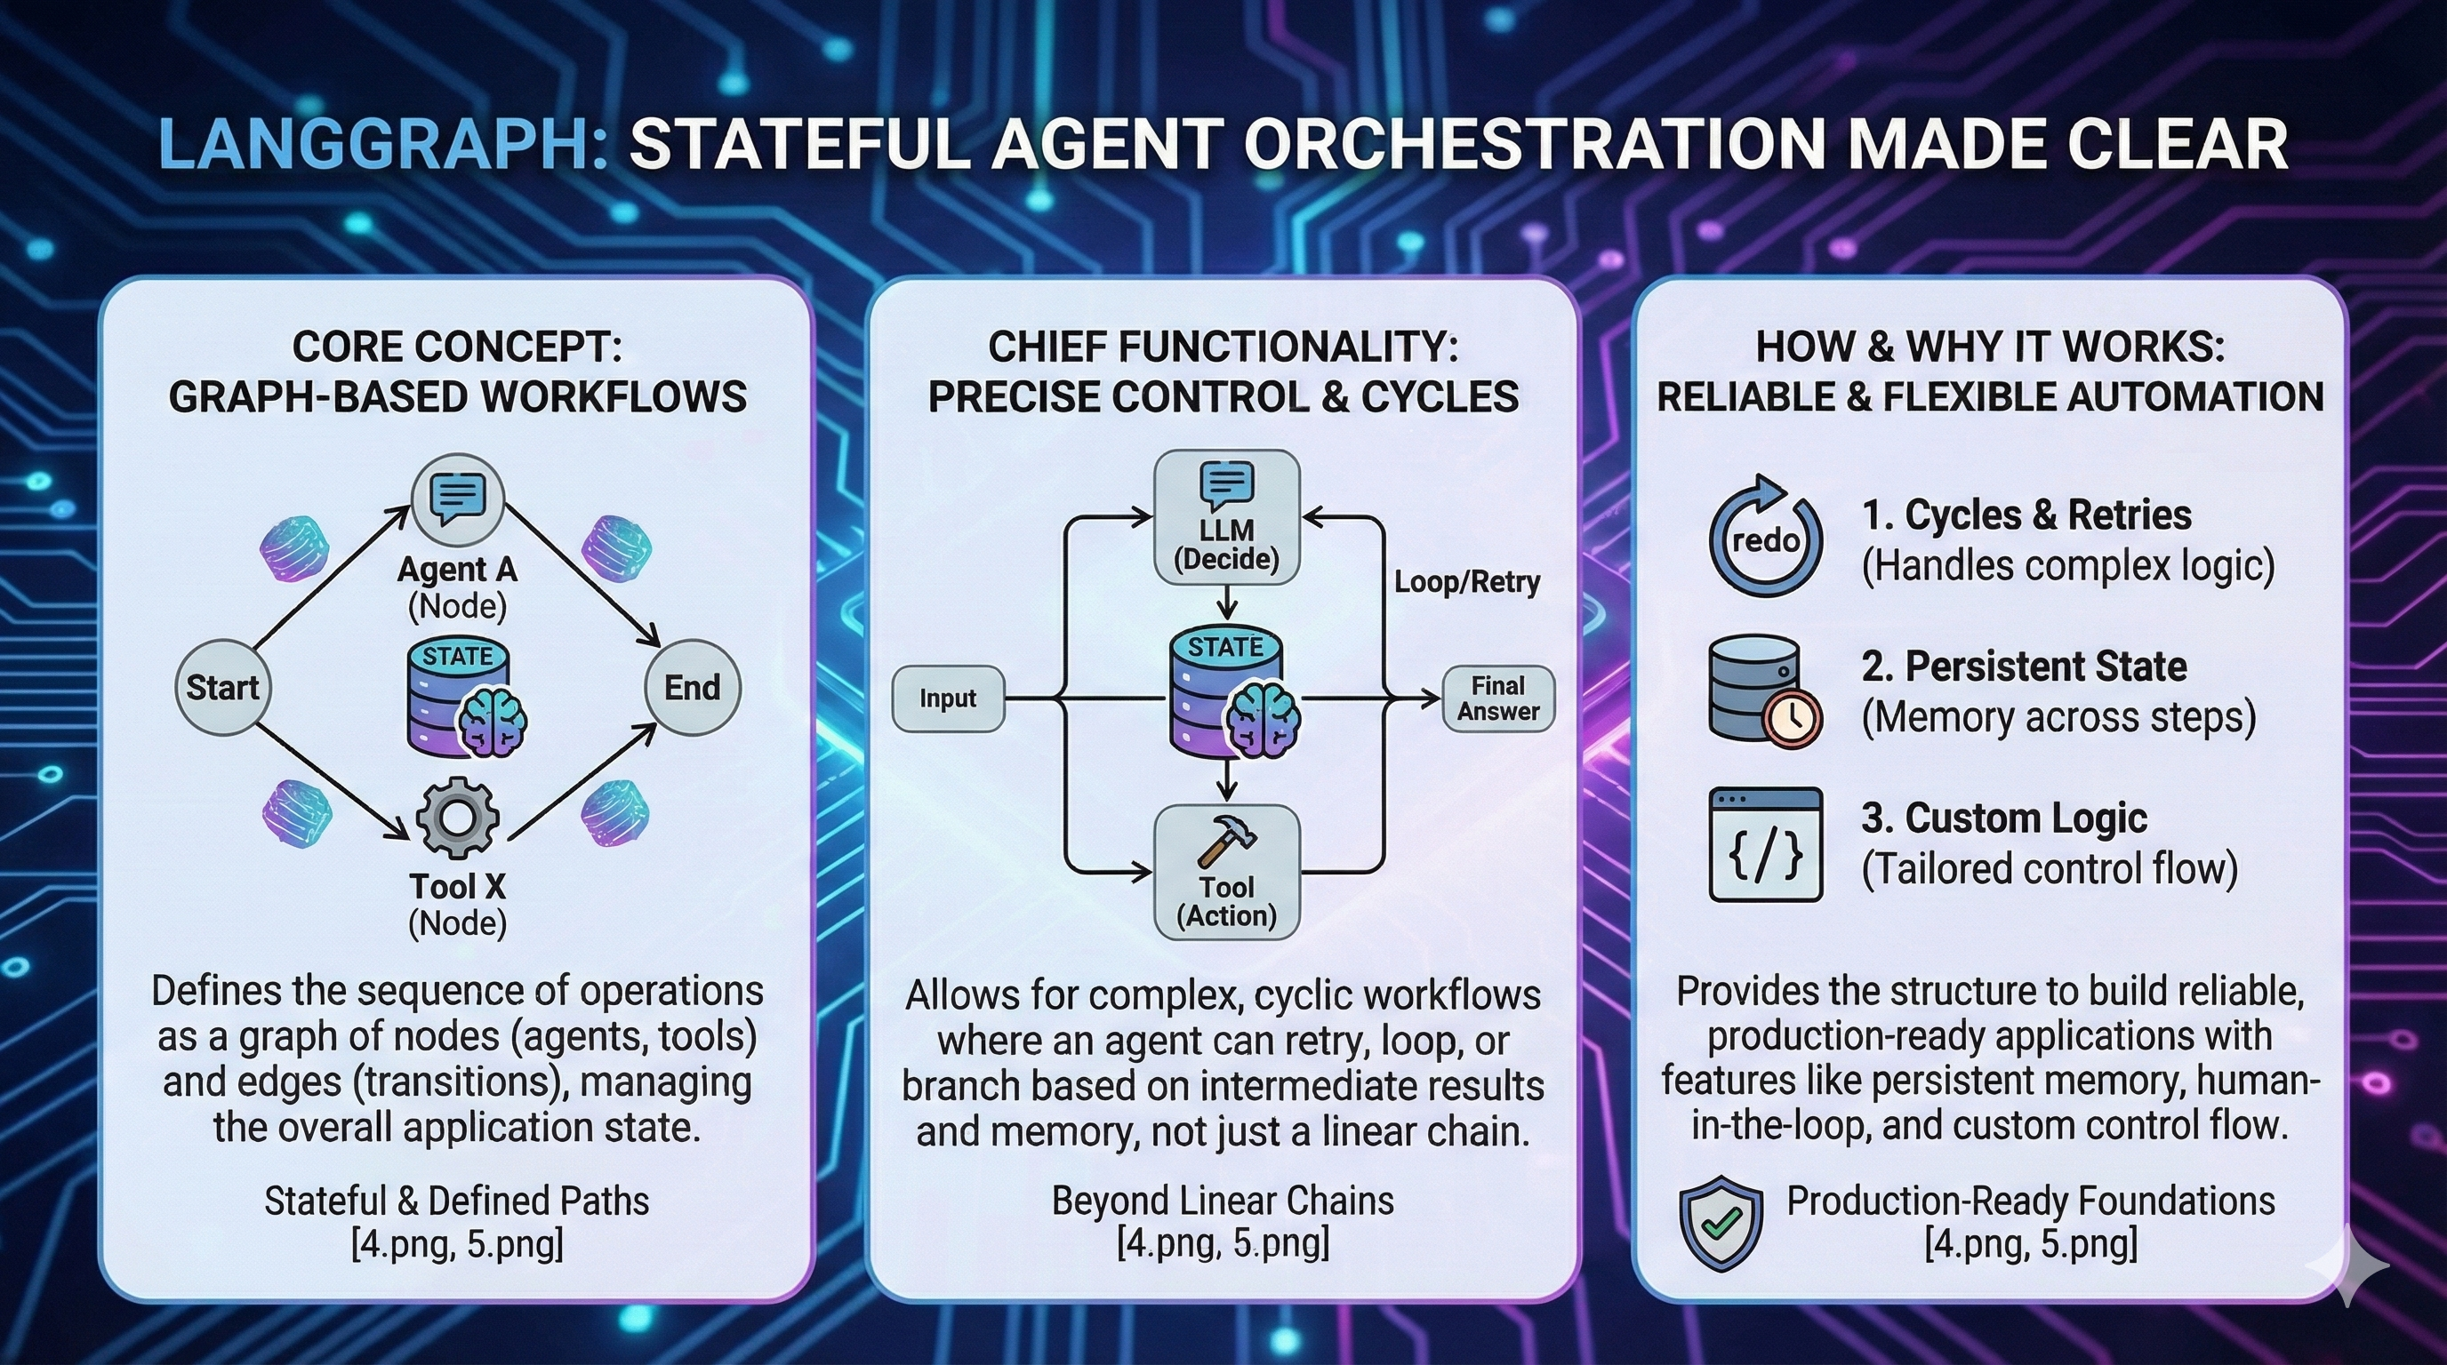

Slide 30
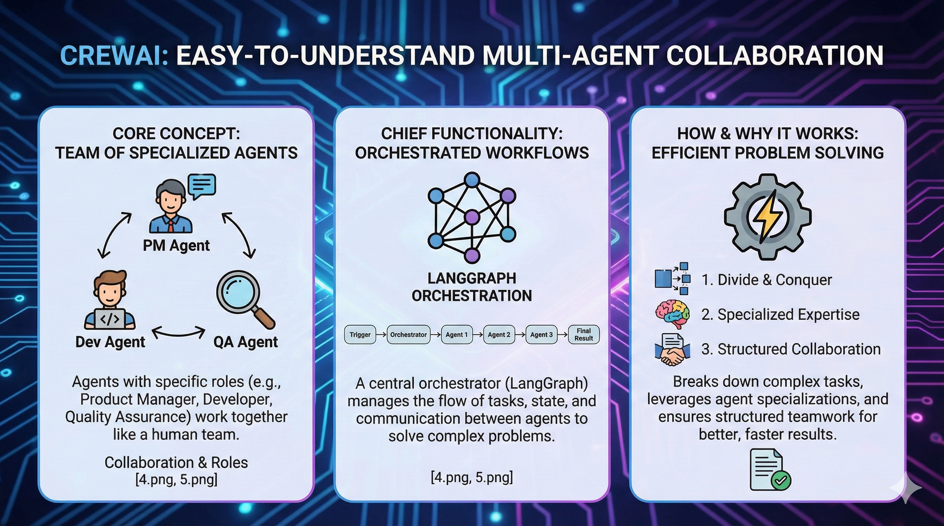

Slide 31
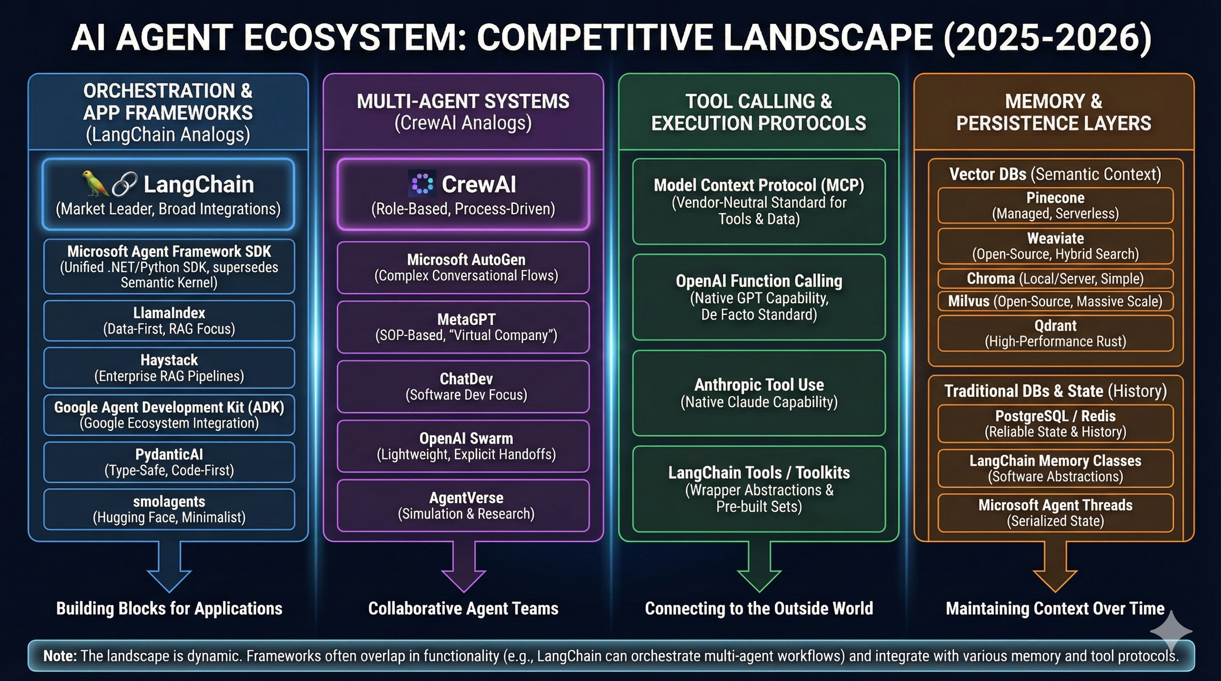

Slide 32
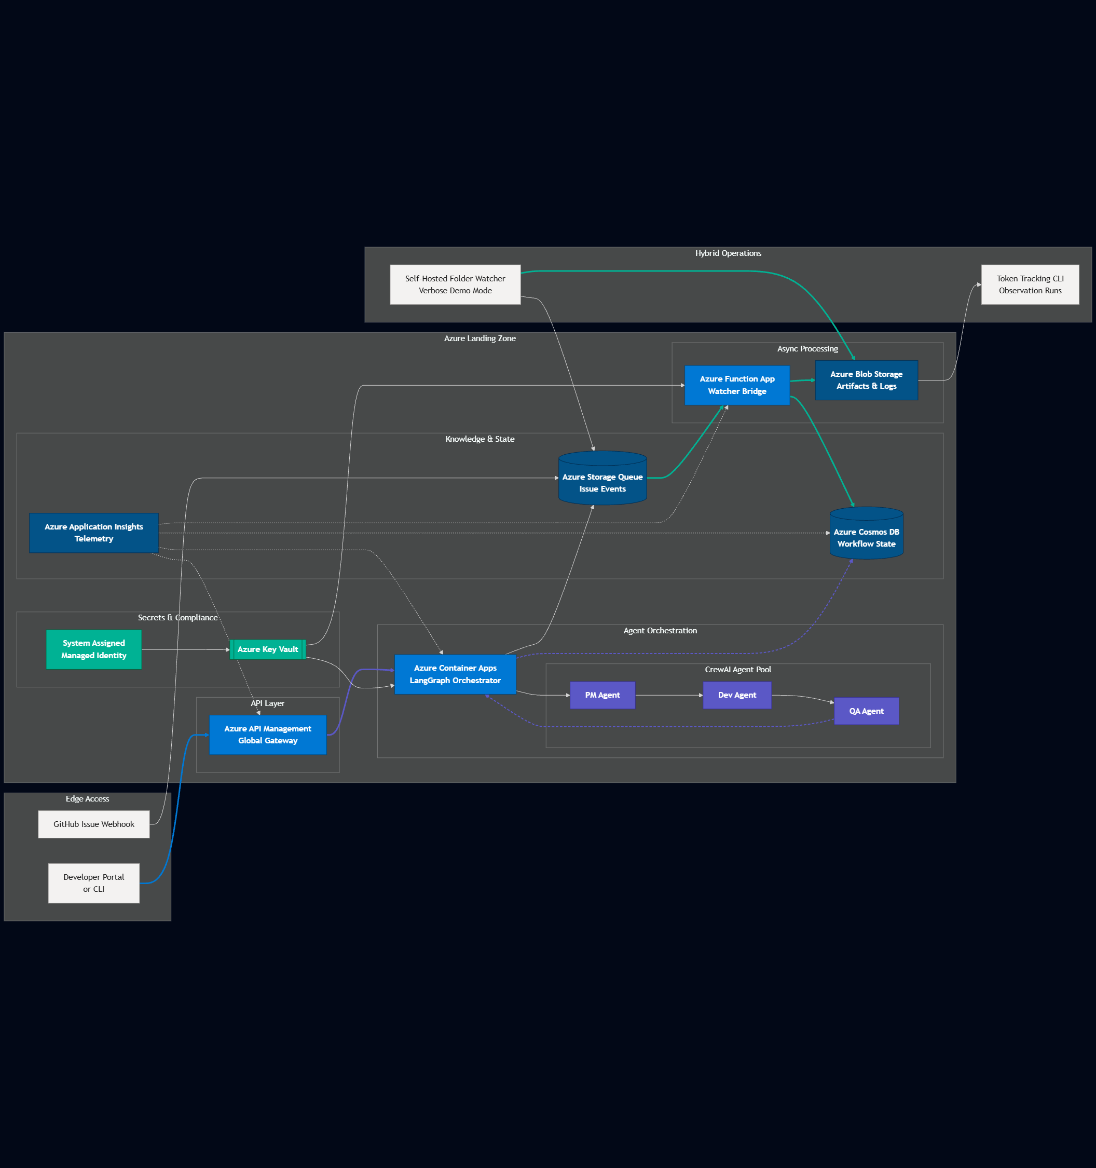

Slide 33
Thank you!
Course materials: timw.info/claude
Contact: TechTrainerTim.com

